Slide 1



CRACKATHON’24
FROM IDEA
TO MVP

Slide 2




Minimum
WHAT IS MVP
Core Functionality
Simplified Scope
Basic User Flow
MVP stands for Minimum Viable Product
Viable
Usable & Valuable
Addresses a Core Problem
Scalability Consideration
Product
Functional Prototype
Minimum Marketable Product
Ready for Testing

Slide 3


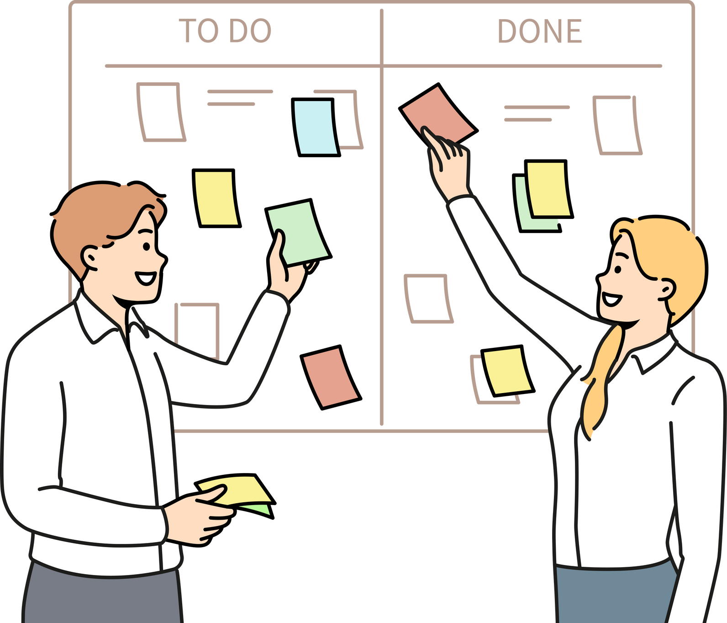




IDEA GENARATION
PROBLEM IDENTIFICATION
USER-CENTRIC
APPROACH
BRAINSTROMING
CURRENT TRENDS
HACKATHON THEME
FEASABILITY
& IMPACT

Slide 4


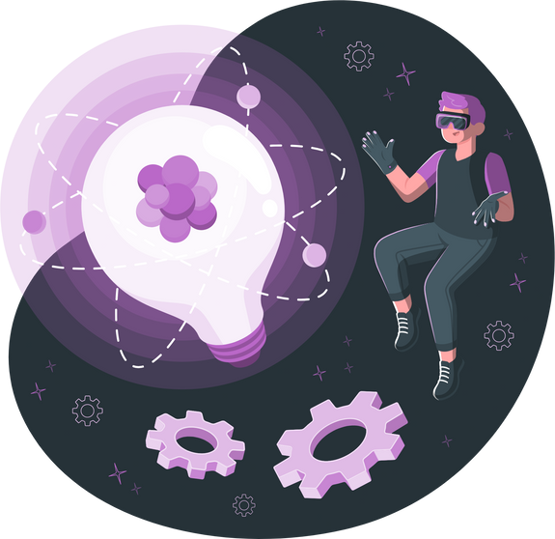
DEFINE YOUR IDEA
PROBLEM STATEMENT
TERGET AUDIENCE
INOVATION & UNIQUENESS

Slide 5





IDENTIFY CORE FEATURES
PROBLEM CENTRIC FEATURES
MVP
USER FLOW
ITERATIVE DEVELOPMENT
TECHNICAL FEASABILITY
INNOVATION

Slide 6


CREATE A USER FLOW
Define User Personas
Map User journey
Visual Mapping
Task Sequencing
Entry points
Decision Points

Slide 7



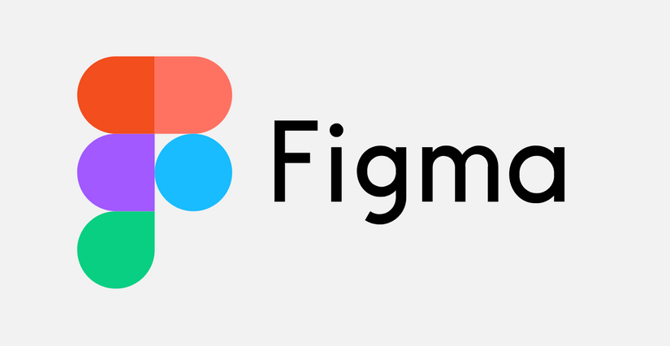
DESIGN WIREFRAMES

Slide 8
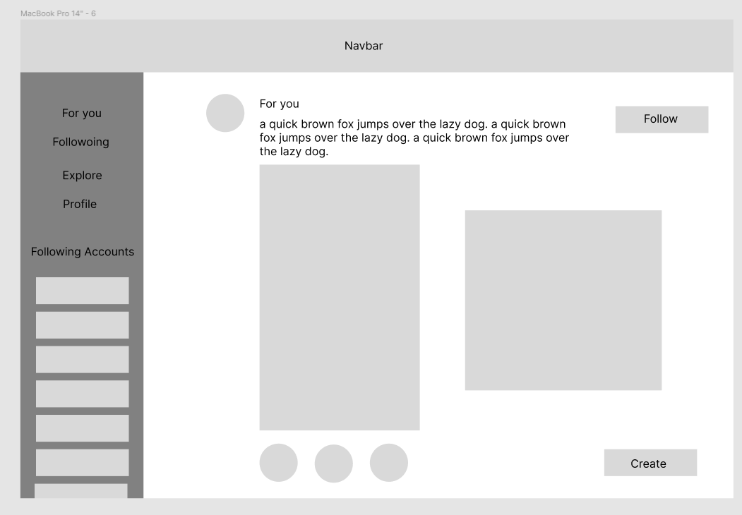

Slide 9
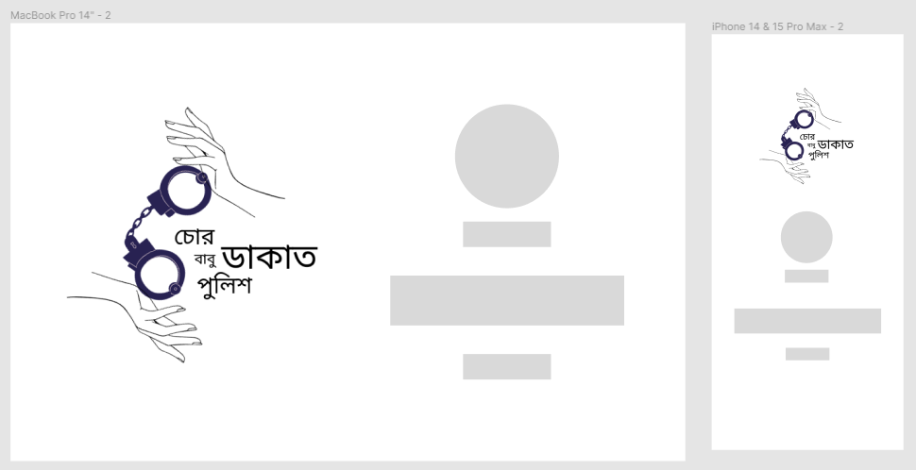

Slide 10

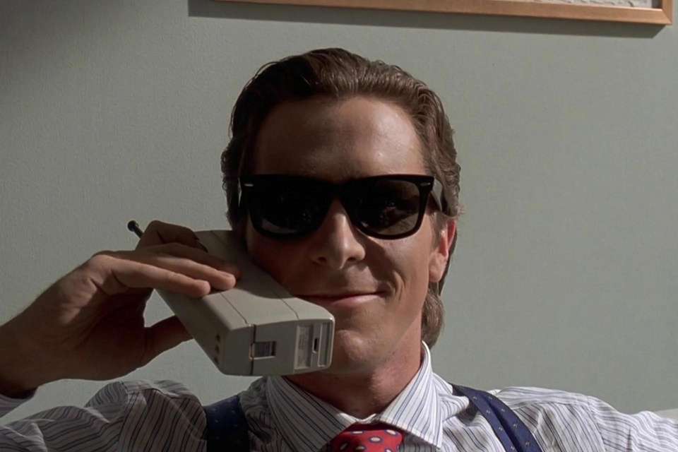
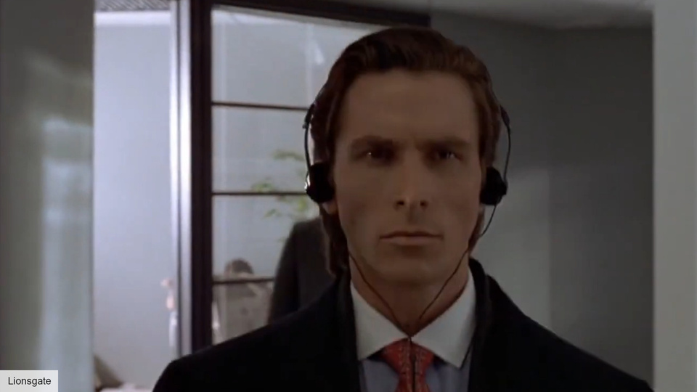
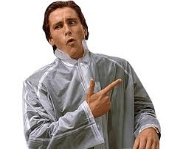
DIVIDE THE TASK
MEMBER 1
FRONTEND
MEMBER 2
BACKEND
MEMBER 3
FULL STACK

Slide 11

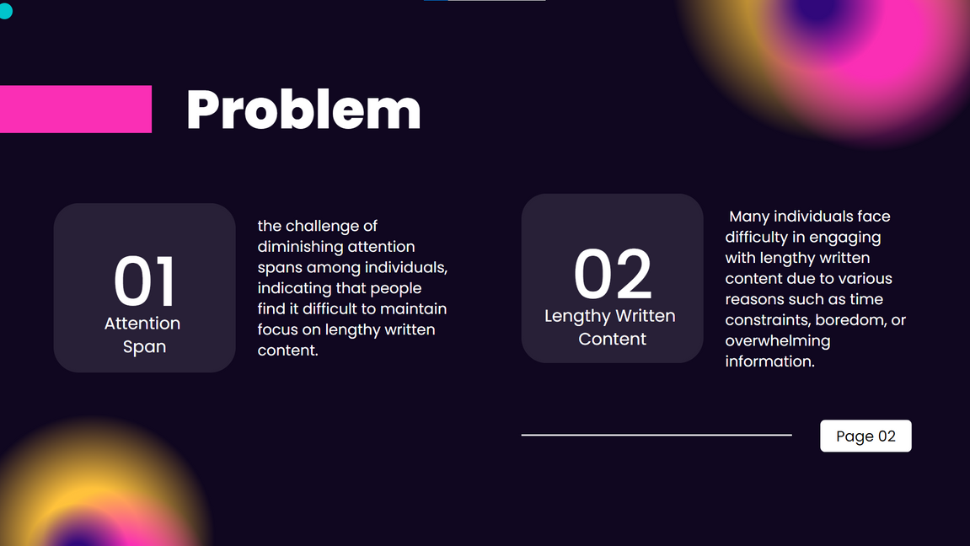
PREPARE
PRESENTATION

Slide 12












CHOOSE TECH STACK

Slide 13
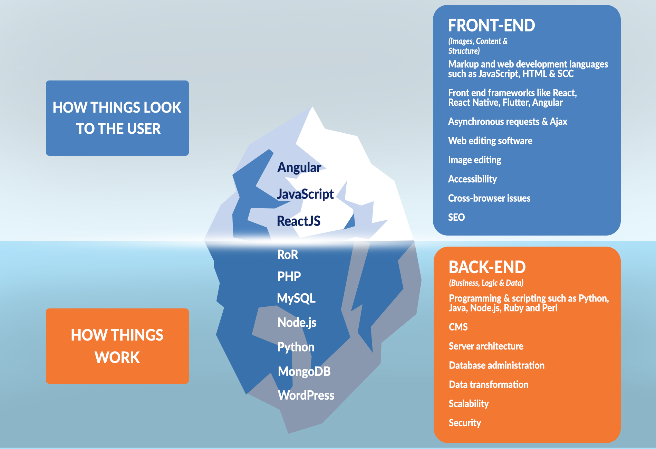

Slide 14
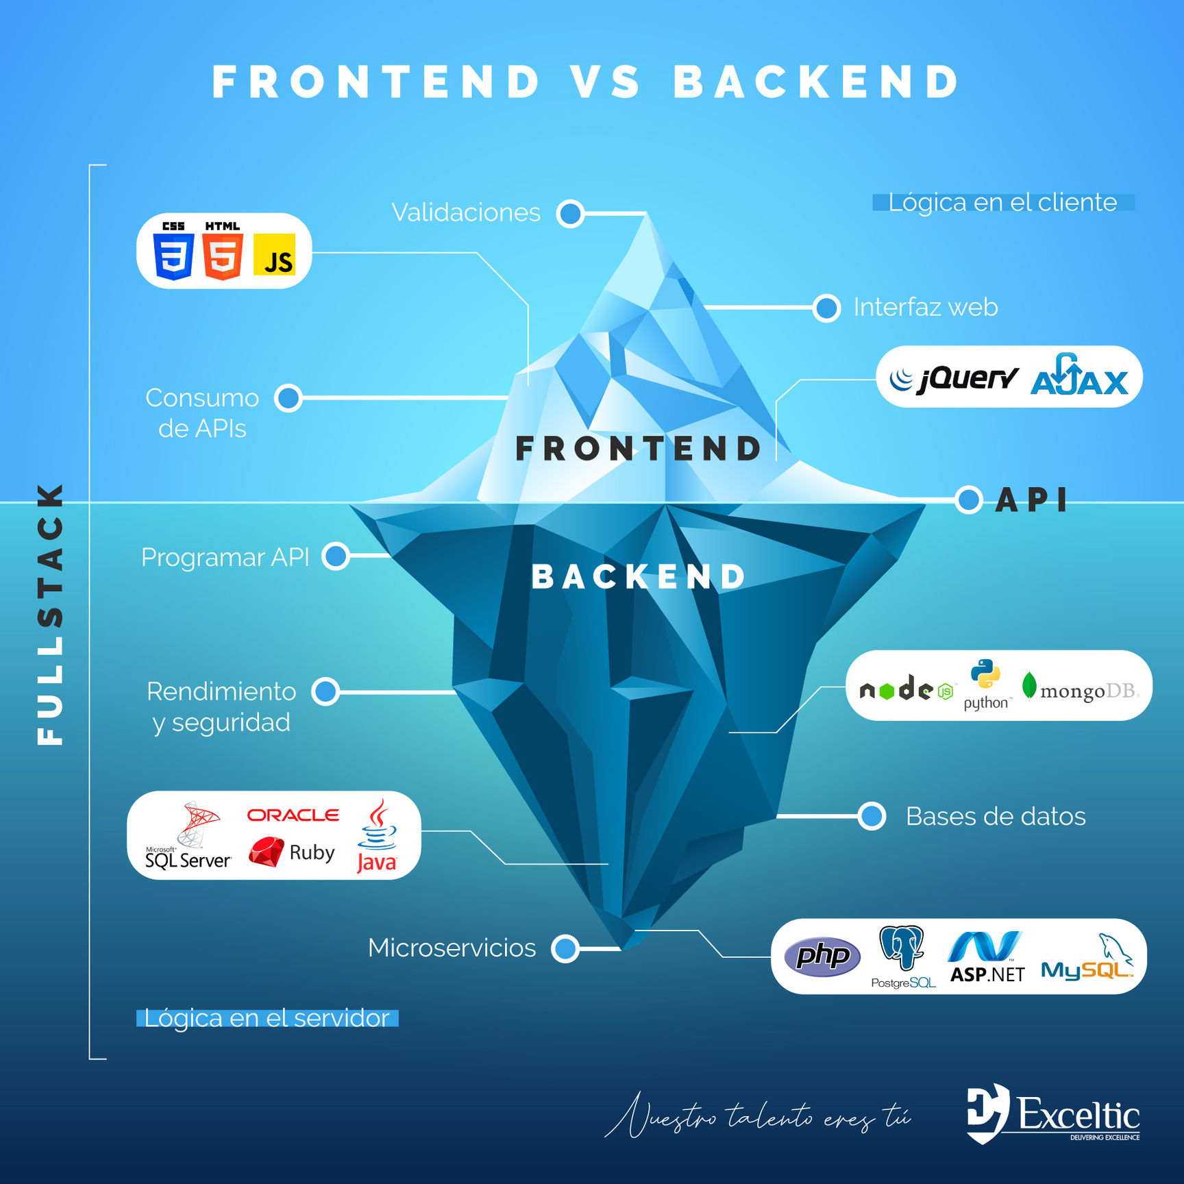

Slide 15
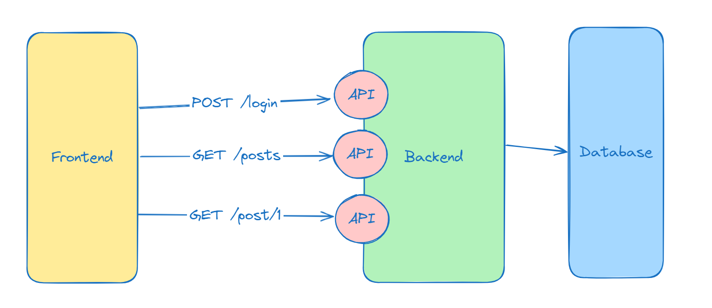

Slide 16
FRONTEND
TASKS
UI / UX
Responsiveness
Cross browser compatibility
Client Side development
Integration with backend

Slide 17
BACKEND
TASKS
Server-Side Logic
Database management
Making API
Authentication and Authorization
Business logic
Security & Scalability

Slide 18


TEST & DEMO

Slide 19
IN SUMMARY
Idea generation
Define your idea
Identify core features
Create user flow
Design wireframes
Divide the task
Prepare presentation
Frontend Implementation
Backend Implementation
API Integration
Test & Demo

Slide 20
CRACKATHON’24
THANKS!
Md. Mehrajul Islam

